Slide 1
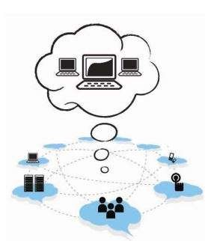
UNIT - 1

Slide 2
Computing Paradigms
High-Performance Computing
Parallel Computing
Distributed Computing
Cluster Computing
Grid Computing
Cloud Computing
Bio computing
Mobile Computing
Quantum Computing
Optical Computing
Nano computing

Slide 3
What is Cloud Computing?
Distributed computing on internet Or delivery of computing service over the internet.
Eg: Yahoo!, GMail, Hotmail-
Instead of running an e-mail program on your computer, you log in to a Web e-mail account remotely. The software and storage for your account doesn't exist on your computer -- it's on the service's computer cloud.

Slide 4
What is Cloud Computing?
Cloud Computing refers to manipulating, configuring, and accessing the applications online.
It offers online data storage, infrastructure and application.
Cloud Computing is both a combination of software and hardware based computing resources delivered as a network service.

Slide 5
High-Performance Computing
In high-performance computing systems, a pool of processors (processor machines or central processing units [CPUs]) connected (networked) with other resources like memory, storage, and input and output devices, and the deployed software is enabled to run in the entire system of connected components.
The processor machines can be of homogeneous or heterogeneous type. The legacy meaning of high-performance computing (HPC) is the supercomputers.

Slide 6
From other resources…
High-performance computing (HPC) is the ability to process data and perform complex calculations at high speeds.
To put it into perspective, a laptop or desktop with a 3 GHz processor can perform around 3 billion calculations per second.
While that is much faster than any human can achieve, it pales in comparison to HPC solutions that can perform quadrillions of calculations per second.

Slide 7
From other resources…
One of the best-known types of HPC solutions is the supercomputer.
A supercomputer contains thousands of compute nodes that work together to complete one or more tasks.
This is called parallel processing.
It’s similar to having thousands of PCs networked together, combining compute power to complete tasks faster.

Slide 8
Examples of High-Performance Computing…..
HPC include
a small cluster of desktop computers
personal computers (PCs) to the fastest supercomputers.
HPC systems are normally found in those applications where it is required to use or solve scientific problems.
Most of the time, the challenge in working with these kinds of problems is to perform suitable simulation study, and this can be accomplished by HPC without any difficulty.
Scientific examples such as protein folding in molecular biology and studies on developing models and applications based on nuclear fusion are worth noting as potential applications for HPC.

Slide 9
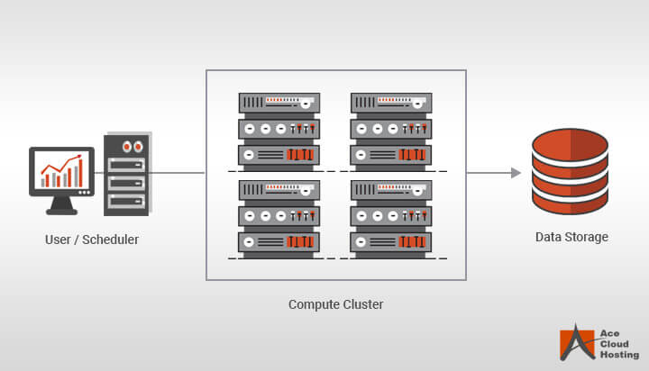
There are three key components of high-performance computing solutions: compute, network, and storage.
In order to develop a high-performance computing architecture, multiple computer servers are networked together to form a cluster.
Algorithms and software programs are executed concurrently on the servers in the cluster.
To get the results, the cluster is networked to data storage. These modules function together to complete different tasks

Slide 10
High-Performance Computing Use Cases
Financial services: HPC is being used to monitor real-time stock trends and automate trading.
Research labs: HPC is used by scientists to find sources of renewable energy, create new materials, make predictions about storms, and study the evolution of the universe. HPC is also being used by researchers in geology, social media, brain imaging, semantics, economics, genomics, and even music.
Healthcare: HPC is being used by healthcare specialists to cure diseases such as diabetes and cancer for more accurate and faster diagnosis of the patient.
Entertainment industry: Professionals in the media and entertainment industry use HPC to edit feature films, stream live events, and render special effects.

Slide 11
High-Performance Computing Use Cases….
Oil and gas: With the help of high-performance computing systems, one can identify where to drill for new wells.
Machine Learning and Artificial Intelligence: HPC can be used to improve cancer screening methods, uncover credit card fraud, offer self-assisted technical support, and teach self-driving vehicles.
Industry: HPC can be used to improve products, reduce the time taken to develop new products, and also reduce production costs.
Big Data: As our ability to gather information increases, high-performance computing systems can be highly useful to analyze this data.

Slide 12
Benefits of High-Performance Computing
Below are two main benefits offered by the HPC systems:
Saves Money: With fast processing ability of high-performance computing systems, companies can deliver faster results in saving money.
b) Streamline Business Processes: HPC systems can customize many business processes allowing users to get more done in less time. The ability to analyze data faster allows the financial team to identify the gaps and deliver results.

Slide 13
Parallel Computing
Parallel computing is also one of the facets (characteristic) of HPC.
Here, a set of processors work cooperatively to solve a computational problem.
These processor machines or CPUs are mostly of homogeneous type.
Therefore, this definition is the same as that of HPC and is broad enough to include supercomputers that have hundreds or thousands of processors interconnected with other resources.
One can distinguish between conventional (also known as serial or sequential or Von Neumann) computers and parallel computers in the way the applications are executed.

Slide 14
serial vs parallel computing
Serial Computing
In serial or sequential computers, the following apply:
It runs on a single computer/processor machine having a single CPU
A problem is broken down into a discrete series of instructions.
Instructions are executed one after another.

Slide 15
Parallel Computing
In parallel computing, since there is simultaneous use of multiple processor machines, the following apply:
It is run using multiple processors (multiple CPUs).
A problem is broken down into discrete parts that can be solved concurrently
Each part is further broken down into a series of instructions.
Instructions from each part are executed simultaneously on different processors.
An overall control/coordination mechanism is employed.

Slide 16
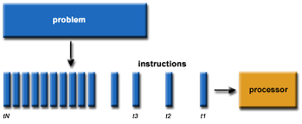
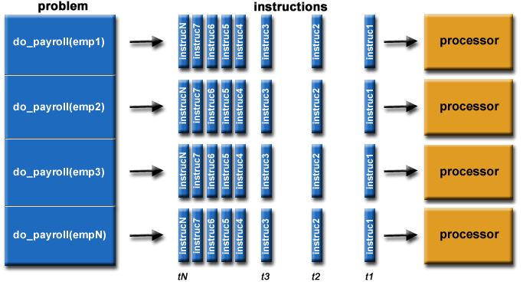
Serial computing
serial vs parallel computing
Parllel computing

Slide 17
Distributed Computing
Distributed computing is also a computing system that consists of multiple computers or processor machines connected through a network, which can be homogeneous or heterogeneous, but run as a single system.
The connectivity can be such that the CPUs in a distributed system can be physically close together and connected by a local network, or they can be geographically distant and connected by a wide area network.
The heterogeneity in a distributed system supports any number of possible configurations in the processor machines, such as mainframes, PCs, workstations, and minicomputers.

Slide 18
Distributed Computing….
The goal of distributed computing is to make such a network work as a single computer.
Distributed computing systems are advantageous over centralized systems, because there is a support for the following characteristic features:
1. Scalability: It is the ability of the system to be easily expanded by
adding more machines as needed, and vice versa,
without affecting the existing setup.
2. Redundancy or replication: Here, several machines can provide the
same services, so that even if one is
unavailable (or failed), work does not
stop because other similar computing
supports will be available.

Slide 19
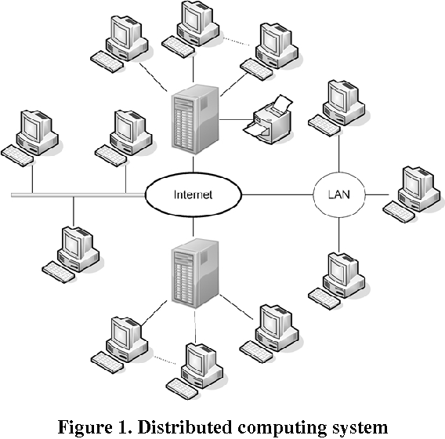

Slide 20
Cluster Computing
A cluster computing system consists of a set of the same or similar type of processor machines connected using a dedicated network infrastructure.
All processor machines share resources such as a common home directory and have a software such as a message passing interface (MPI) implementation installed to allow programs to be run across all nodes simultaneously.
This is also a kind of HPC category. The individual computers in a cluster can be referred to as nodes.

Slide 21
Cluster Computing….
The reason to realize a cluster as HPC is due to the fact that the individual nodes can work together to solve a problem larger than any computer can easily solve.
And, the nodes need to communicate with one another in order to work cooperatively and meaningfully together to solve the problem in hand.
If we have processor machines of heterogeneous types in a cluster, this kind of clusters become a subtype and still mostly are in the experimental or research stage.

Slide 22
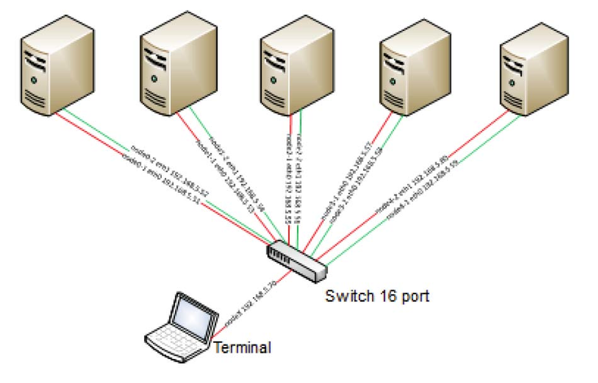
Cluster Computing

Slide 23
Grid Computing
The computing resources in most of the organizations are underutilized but are necessary for certain operations.
The idea of grid computing is to make use of such nonutilized computing power by the needy organizations, and thereby the return on investment (ROI) on computing investments can be increased.
Thus, grid computing is a network of computing or processor machines managed with a kind of software such as middleware, in order to access and use the resources remotely.

Slide 24
Grid Computing….
The managing activity of grid resources through the middleware is called grid services.
Grid services provide access control, security, access to data including digital libraries and databases, and access to large-scale interactive and long-term storage facilities.
Grid computing is more popular due to the following reasons:
Its ability to make use of unused computing power, and thus, it is a cost-effective solution (reducing investments, only recurring costs)
As a way to solve problems in line with any HPC-based application
Enables heterogeneous resources of computers to work cooperatively and collaboratively to solve a scientific problem.

Slide 25
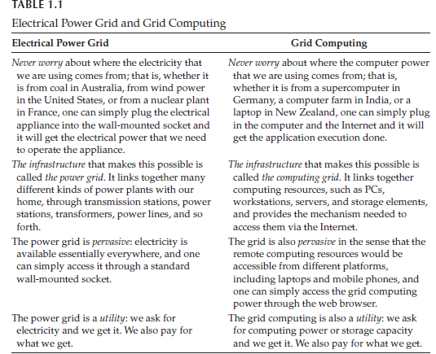

Slide 26
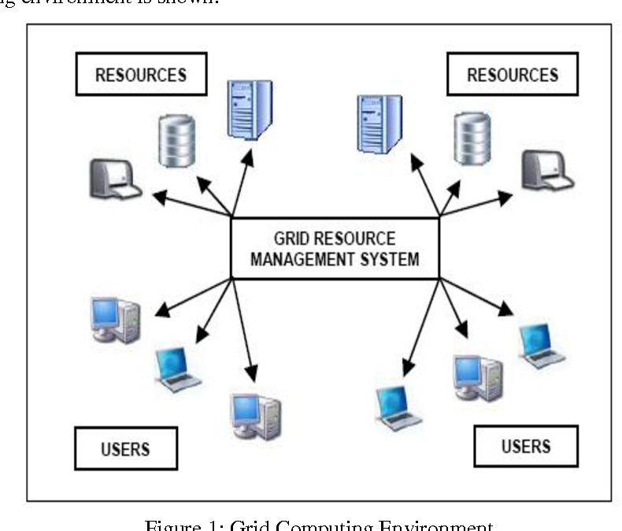

Slide 27
Cloud Computing
The computing trend moved toward cloud from the concept of grid computing, particularly when large computing resources are required to solve a single problem, using the ideas of computing power as a utility and other allied concepts.
However, the potential difference between grid and cloud is that grid computing supports leveraging several computers in parallel to solve a particular application,
while cloud computing supports leveraging multiple resources, including computing resources, to deliver a unified service to the end user.

Slide 28
Cloud Computing….
In cloud computing, the IT and business resources, such as servers, storage, network, applications, and processes, can be dynamically provisioned to the user needs and workload.
In addition, while a cloud can provision and support a grid, a cloud can also support nongrid environments, such as a three-tier web architecture running on traditional or Web 2.0 applications.

Slide 29
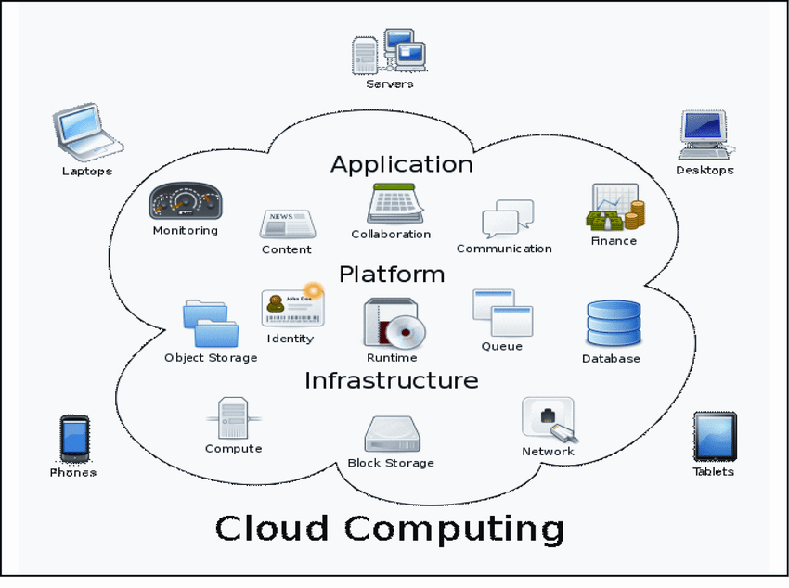

Slide 30
Bio-computing
Biocomputing systems use the concepts of biologically derived or simulated molecules (or models) that perform computational processes in order to solve a problem.
The biologically derived models aid in structuring the computer programs that become part of the application.
Biocomputing provides the theoretical background and practical tools for scientists to explore proteins and DNA (Deoxyribonucleic acid).

Slide 31
Bio-computing…..
DNA and proteins are nature’s building blocks, but these building blocks are not exactly used as bricks; the function of the final molecule rather strongly depends on the order of these blocks.
Thus, the biocomputing scientist works on inventing the order suitable for various applications mimicking biology.
Biocomputing shall, therefore, lead to a better understanding of life and the molecular causes of certain diseases.

Slide 32
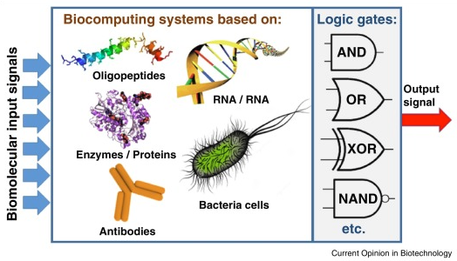
the design and construction of computers using biochemical components.
an approach to programming that seeks to emulate or model biological processes.
computing in a biological context or environment.

Slide 33
Mobile Computing
In mobile computing, the processing (or computing) elements are small (i.e., handheld devices) and the communication between various resources is taking place using wireless media.
Mobile communication for voice applications (e.g., cellular phone) is widely established throughout the world and witnesses a very rapid growth in all its dimensions including the increase in the number of subscribers of various cellular networks.
An extension of this technology is the ability to send and receive data across various cellular networks using small devices such as smartphones.

Slide 34
Mobile Computing…..
There can be numerous applications based on this technology; for example, video call or conferencing is one of the important applications that people prefer to use in place of existing voice (only) communications on mobile phones.
Mobile computing–based applications are becoming very important and rapidly evolving with various technological advancements as it allows users to transmit data from remote locations to other remote or fixed locations.

Slide 35
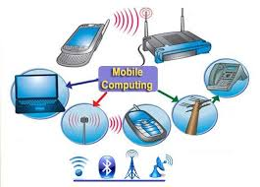

Slide 36
Quantum Computing
Manufacturers of computing systems say that there is a limit for cramming(overfill) more and more transistors into smaller and smaller spaces of integrated circuits (ICs) and thereby doubling the processing power about every 18 months.
This problem will have to be overcome by a new quantum computing–based solution,
Quantum computers are millions of times faster than even our most powerful supercomputers today.
Since quantum computing works differently on the most fundamental level than the current technology, and although there are working prototypes, these systems have not so far proved to be alternatives to today’s silicon-based machines.

Slide 37
Optical Computing
Optical computing system uses the photons in visible light or infrared beams, rather than electric current, to perform digital computations.
An electric current flows at only about 10% of the speed of light. This limits the rate at which data can be exchanged over long distances and is one of the factors that led to the evolution of optical fiber.
By applying some of the advantages of visible and/or IR networks at the device and component scale, a computer can be developed that can perform operations 10 or more times faster than a conventional electronic computer.

Slide 38
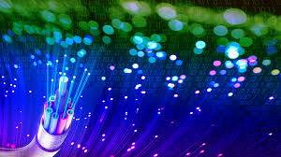
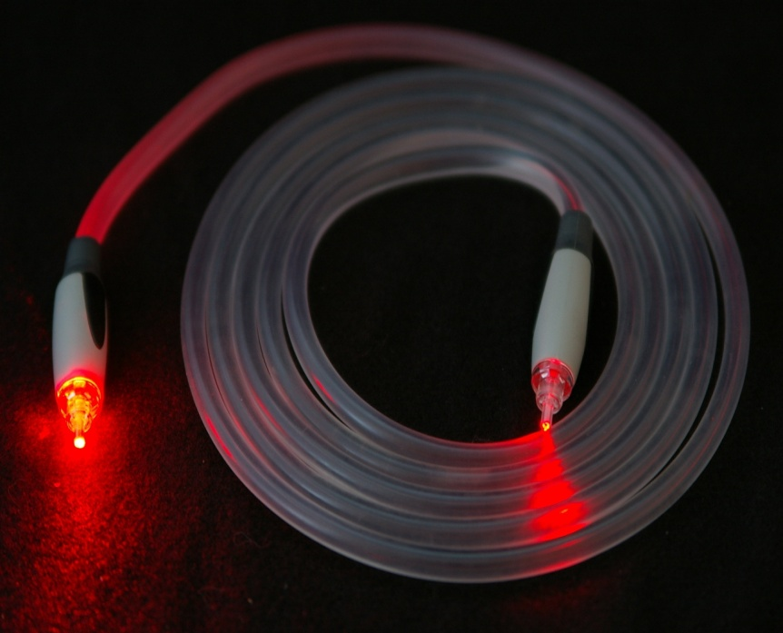
Optical cable

Slide 39
Nanocomputing
Nanocomputing refers to computing systems that are constructed from nanoscale components.
The silicon transistors in traditional computers may be replaced by transistors based on carbon nanotubes.
The successful realization of nanocomputers relates to the scale and integration of these nanotubes or components.

Slide 40
Nanocomputing…..
The issues of scale relate to the dimensions of the components; they are, at most, a few nanometers in at least two dimensions.
The issues of integration of the components are twofold: first, the manufacture of complex arbitrary patterns may be economically infeasible, and second, nanocomputers may include massive quantities of devices.
Researchers are working on all these issues to bring nanocomputing a reality.

Slide 41
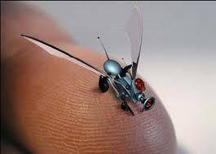
Nano computing

Slide 42
Thank You
For Your Attention…

